Slide 1
MicroServices
Shalini Mittal
Corporate Trainer

Slide 2
Topics to be covered
Logging, Tracing and Metrics
Data Collaboration
Chain Of responsibility
Asynchronous Messaging
Data Management
Twelve Factor App
Hexagonal pattern

Slide 3
Observability Patterns

Slide 4
Patterns
Log aggregation — aggregate application logs
Application metrics — instrument a service’s code to gather statistics about operations
Audit logging — record user activity in a database
Distributed tracing — instrument services with code that assigns each external request an unique identifier that is passed between services. Record information (e.g. start time, end time) about the work (e.g. service requests) performed when handling the external request in a centralized service
Exception tracking — report all exceptions to a centralized exception tracking service that aggregates and tracks exceptions and notifies developers.
Health check API — service API (e.g. HTTP endpoint) that returns the health of the service and can be pinged, for example, by a monitoring service
Notes:
Services may span across multiple servers, even spread across geographical boundaries. This creates many log files since each microservice maintains its own set of data More importantly, these log files need to be in proper order to easily debug a problem -- a correlation ID is used to correlate the calls through various microservices. A single logging strategy establishes one place where all logs are stored, rather than dispersing them across multiple services.

Slide 5
Log Aggregation
The application consists of multiple services and service instances that are running on multiple machines. Requests often span multiple service instances.
Each service instance generates writes information about what it is doing to a log file in a standardized format. The log file contains errors, warnings, information and debug messages.
Use a centralized logging service that aggregates logs from each service instance.
The users can search and analyze the logs. They can configure alerts that are triggered when certain messages appear in the logs.
In a microservices-based application, you have many different components working together.
Each service in a microservices-based application should have its own monitoring and logging strategy to address issues proactively.
Notes:
Services may span across multiple servers, even spread across geographical boundaries. This creates many log files since each microservice maintains its own set of data More importantly, these log files need to be in proper order to easily debug a problem -- a correlation ID is used to correlate the calls through various microservices. A single logging strategy establishes one place where all logs are stored, rather than dispersing them across multiple services.

Slide 6
Microservice Logging Best Practices
Use a correlation ID: A unique to segregate sets of operations and track individual requests.
Structure logs appropriately: Use same log structure and semantics across microservices. A methodology that creates logs based on a consistent, predetermined message format.
Provide informative application logs: log should include all the needed information pertaining to the issue. Logs should, at a bare minimum, include the following information: Service name, Username, IP address, Correlation ID, Message received time in UTC, Time taken, Method name, Call stack
Visualize log data: need to examine the state of an application, as well as information on any issues, downtimes or latency. Teams can add dashboard features that provide a visual depiction of the information carried into the application logs. There are various log visualization tools available, such as Scalyr, Graylog, Kibana and Sematext.

Slide 7
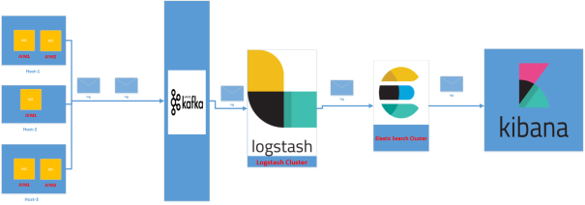
Microservice Logging Best Practices
Use centralized log storage Individual log storage adds a lot of complexity to log retrieval and analytics.
Query logs: Teams can query the log data to find out the percentage of failed requests, the time taken by each request and the frequency of each service call. One way to supplement this is to use a tool that can aggregate log data, such as the ELK stack, Splunk or Sumo Logic.
Handle failures: Application deployments should rely on an automated alert system that can analyze the logs and send out alerts whenever something goes wrong with one or more services

Slide 8
Log Aggregation and Management Tools
Fluentd. This open source window-based data collection tool can unify data collection and consumption. It takes advantage of standard built-in parsers, and developers can use NLog to log data to a Fluentd node. Fluentd is often used by Docker and Elasticsearch users.
Logstash. This is a lightweight, open source, server-side log aggregator that can work in windows and is used to collect, integrate and parse logs. Logstash consumes much less memory than Fluentd.
Rsyslog. This is a high-performance, modular, secure log processing framework. It supports TCP, TLS and SSL protocols and is compliant with MySQL, PostgreSQL and Oracle databases.
Loggly. This is a popular log analysis and monitoring solution that is adept at logging data from Docker containers. The data captured by Loggly can be used to monitor, analyze and optimize microservices-based applications.

Slide 9
Application Metrics
Instrument a service to gather statistics about individual operations.
Aggregate metrics in centralized metrics service, which provides reporting and alerting. There are two models for aggregating metrics:
push - the service pushes metrics to the metrics service
pull - the metrics services pulls metrics from the service
Prometheus and AWS Cloud Watch are Metrics aggregation services.
Application Metrics pattern provides deep insight into application behavior, but the Aggregating metrics can require significant infrastructure.
Notes:
https://dzone.com/articles/7-things-to-know-getting-started-with-spring-boot

Slide 10
Health Check
Sometimes a service instance can be incapable of handling requests yet still be running.
They might have ran out of database connections. Whenever this occurs, the monitoring system should generate a alert.
Also, the load balancer or service registry should not route requests to the failed service instance.
A service has an health check API endpoint (e.g. HTTP /health) that returns the health of the service.
The API endpoint handler performs various checks e.g: status of DB connections, disk space or any application specific logic

Slide 11
Distributed Tracing Pattern
Requests often span multiple services. Each service handles a request by performing one or more operations, e.g. database queries, publishes messages, etc.
record information (e.g. start time, end time) about the work (e.g. service requests) performed when handling the external request in a centralized service. This can be done by:
Assigns each external request a unique external request id.
Pass this external request id to all services that are involved in handling the request.
Include the external request id while logging.
Records information (e.g. start time, end time) about the requests and operations performed when handling a external request in a centralized service.

Slide 12
Microservice Tracing
Microservices architecture involve multiple services which interact with each other. These microservices collaborate with each other
If suppose during such calls there are some issues like exception has occurred. Or may be there are latency issues due to a particular service taking more than expected time. How do we identify where the issue is occurring.
In regular project we would have used logging to analyze the logs to know more about occurred exceptions and also performance timing. But since microservices involves multiple services we cannot use regular logging. Each Service will be having its own separate logs.
Notes:
So we will need to go through the logs of each service. Also how do we correlate the logs to a request call chain i.e which logs of microservices are related to Request1, which are related to Request2.
https://developer.ibm.com/languages/java/tutorials/monitor-spring-boot-microservices/

Slide 13
MS Communication
Notes:
https://www.novatec-gmbh.de/en/blog/spring-cloud-sprint-a-fast-and-comprehensive-spring-cloud-services-tutorial/
For the project Spring-Cloud-Sprint-master

Slide 14
Microservice Observability
ability to observe all the behaviors be it a success, failure, or exception.
This is useful during debugging when lots of underlying systems are involved and the application becomes slow in any particular situation.
In such case, we first need to identify see which underlying service is actually slow.
Once the slow service is identified, we can work to fix that issue.
Distributed tracing helps in identifying that slow component among in the ecosystem
If you are troubleshooting latency problems or errors in ecosystem, you can filter or sort all traces based on the application, length of trace, annotation, or timestamp. By analyzing these traces, you can decide which components are not performing as per expectations, and you can fix them.
Notes:
If we have observed all the behaviors, then we can act accordingly to solve those issues and make the application more robust and fault-tolerant.

Slide 15
Concepts of Microservice Observability
Metrics:- Stats around the microservices to understand what happened around it over a period of time.
Logging:- They help in analyzing what is happing around the system whether the requests are successful, failure, or exception.
Tracing:- In a microservice ecosystem, a workflow/request can talk to multiple services. So tracing helps us to track the workflow in a productive way.
Notes:
If we have observed all the behaviors, then we can act accordingly to solve those issues and make the application more robust and fault-tolerant.

Slide 16
Data Collaboration

Slide 17
Aggregator Pattern
Aggregator refers to a website or program that collects related items of data and displays them
In microservices the Aggregator Design Pattern is a service that receives a request, then makes requests of multiple services, combines the results and responds to the initiating request.
This pattern proves to be beneficial when you need an output by combining data from multiple services
It is based on the DRY principle. Based on this principle, you can abstract the logic into a composite microservices and aggregate that particular business logic into one service.
there are 3 ways to implement it within Microservices application.
Scatter Gather Pattern
Chained Pattern
Branch Pattern
Notes:
https://www.techtarget.com/searchapparchitecture/tip/A-detailed-intro-to-the-strangler-pattern
What is the strangler pattern?
Picture a motorcycle that works, but could stand to undergo extensive overhauls that will make it run better. One option would be to completely take the motorcycle apart and spend months rebuilding until it works. However, how sure are you that it will run after you've finished replacing every part? And what if you want to use the motorcycle in the next few weeks, but can't while it's in the garage?
The solution there is to replace parts one at a time, ensure it works as expected, and move on to the next once it's done. This provides two major benefits. The first is that you can likely still run the motorcycle as parts are incrementally replaced, rather than having to wait for the rebuild. The second is that if a fix or replacement doesn't work, you'll have a much easier time identifying the problem since you do not have to examine everything at once. Eventually, you will end up with an updated motorcycle that never really stopped running.

Slide 18
Scatter Gather Pattern
This pattern is ideal for requesting responses from multiple parties, then aggregating and processing that data.
It is a composite pattern that illustrates how to “broadcast a message to multiple recipients and re-aggregate the responses back into a single message
In this pattern, parallel calls happen to microservices and the response from all the services is collected and send back
Notes:
A service to get Student Information
A service to get Marks & its related Information
A service to get Membership Information
A service to get Achievements Information
Moreover, you have 2 consumers named as, “Grading System” and “Enrichment Program System” for these 4 services.
But the thing is, what happen when “Grading System” wants student information and marks information, or “Enrichment Program System” wants membership and achievements information?
So, what you can do is, create a service to consume “student information” and “marks information” services and give the response to the consumer that required (Grading System). Basically what happen is, the newly created service will take the request from the “Grading System” and invoked those 2 services to aggregate their responses and send it back to the “Grading System.
https://www.vinsguru.com/scatter-gather-pattern/

Slide 19
Chained Pattern
The request from the client is received by Service A, which is then communicating with Service B, which in turn may be communicating with Service C.
Chained microservice design pattern produce a single consolidated response to the request.
the client is blocked until the complete chain of request/response, i.e. ServiceA calling ServiceB and ServiceB calling ServiceC, is completed
Do not make the chain long
Notes:
It’s all about translation and keeping external concepts out and not leaking in and pushing this translation to the outer edge.
For example, when a legacy application is migrated to a modern system, it may still need existing legacy resources. New features must be able to call the legacy system. This is especially true of gradual migrations, where different features of a larger application are moved to a modern system over time.

Slide 20
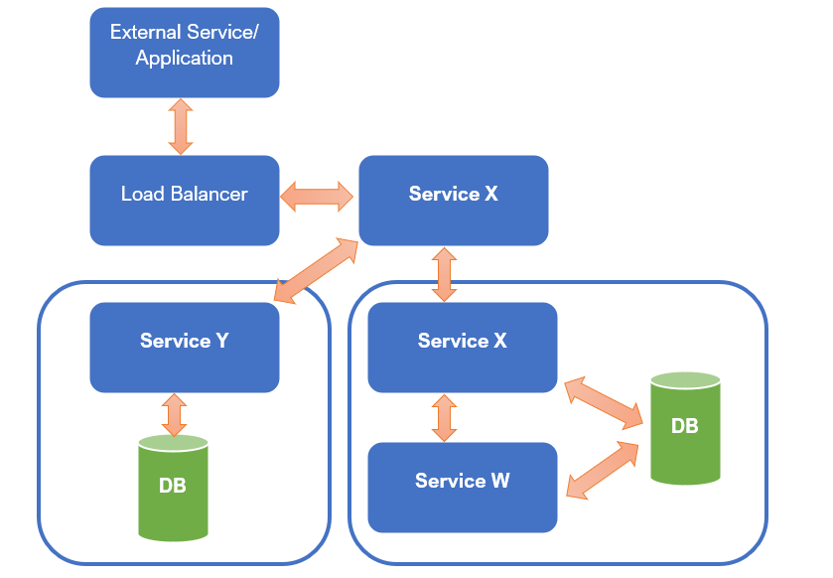
Branch Pattern
This microservices pattern is a mix of Aggregator and Chain design patterns, that allows simultaneous request or response from two or more independent microservices.
It extends the Aggregator Pattern and provides the flexibility to produce responses from multiple chains or single chain. This design pattern comes handy when you need to convert a large monolithic application into a microservices application.

Slide 21
Chain Of Responsibility

Slide 22
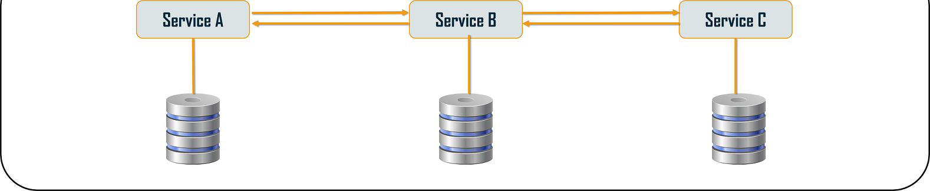
Chain Of Responsibility
The Chain of Responsibility pattern avoids coupling the sender of a request to the receiver by giving more than one object a chance to handle the request.
All these services use synchronous HTTP request or response for messaging. Also, until the request passes through all the services and the respective responses are generated, the client doesn’t get any output
Notes:
https://medium.com/javarevisited/chain-of-responsibility-pattern-in-spring-application-f79b35f341e5

Slide 23
Asynchronous Messaging

Slide 24
Synchronous Messsaging
Communication is synchronous when one service sends a request to another service and waits for the response before proceeding further.
The most common implementation of Sync communication is over HTTP using protocols like REST, GraphQL, and gRPC.
Advantages of Synchronous Communication
It is simple and intuitive
Communication happens in realtime
Disadvantages of Synchronous Communication
Caller is blocked until the response is received
Servers need to be pro-actively provisioned for peaks
There is a risk of cascading failures
The participating services are strongly coupled
When to use Synchronous Communication
When you cannot proceed without a response from the other service
When you want real-time responses
When it takes less time to compute and respond

Slide 25
Asynchronous Messsaging
All of the services in this type of microservices design pattern can communicate with each other, but they do not have to communicate sequentially
Async communication is most commonly implemented using a message broker like RabbitMQ, SQS, Kafka, Kinesis, etc.
Advantages of Asynchronous Communication
Services do not need to wait for the response and can move on
Services can handle surges and spikes better
Servers do not need to be proactively provisioned
No extra network hop due to Load Balancer
No request drop due to target service being overwhelmed
Better control over failures and retires is possible
Services are truly decoupled
Notes:
https://howtodoinjava.com/spring-restful/spring-restful-client-resttemplate-example/
https://docs.spring.io/spring/docs/current/javadoc-api/org/springframework/web/client/RestTemplate.html

Slide 26
Asynchronous Messsaging
Disadvantages of Asynchronous Communication
Eventual consistency
Broker could become a SPoF
It is harder to track the flow of the message between services
When to use Asynchronous Communication
When delay in processing is okay
When the job at hand is long-running and takes time to execute
When multiple services need to react to the same event
When it is okay for the processing to fail and you are allowed to retry
Asynchronous communication leverages events to facilitate communication between microservices, which is commonly referred to as event-driven communication.
Notes:
https://howtodoinjava.com/spring-restful/spring-restful-client-resttemplate-example/
https://docs.spring.io/spring/docs/current/javadoc-api/org/springframework/web/client/RestTemplate.html

Slide 27
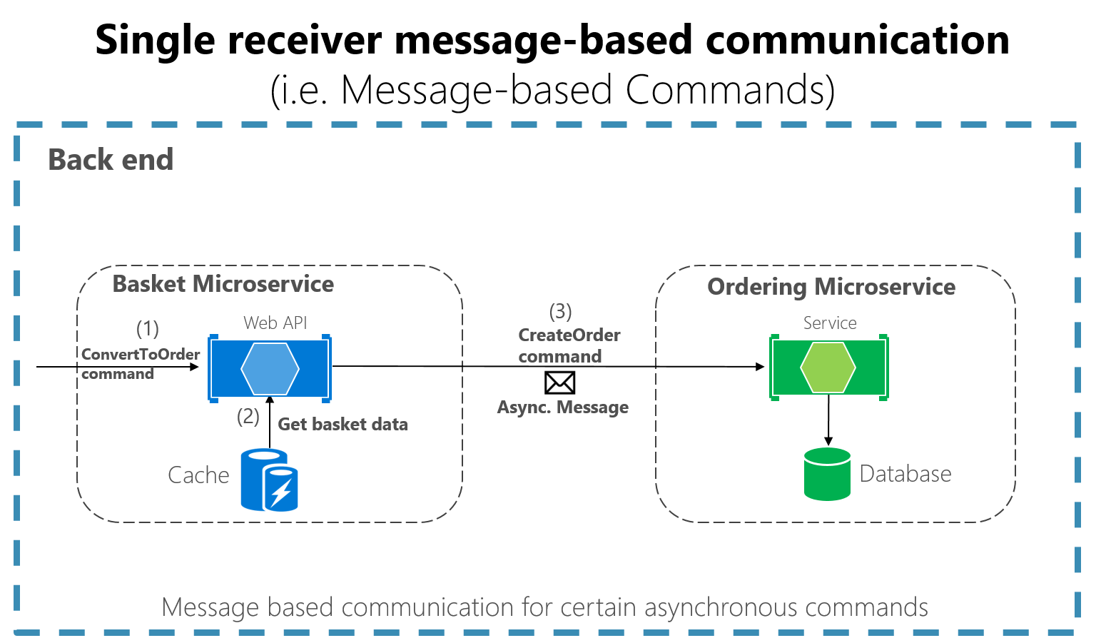
Communication Types - Messaging Queue
Message-based asynchronous communication with a single receiver means there's point-to-point communication that delivers a message to exactly one of the consumers that's reading from the channel, and that the message is processed just once.
Notes:
https://www.journaldev.com/8195/spring-boot-cli-setup-and-helloworld-example

Slide 28
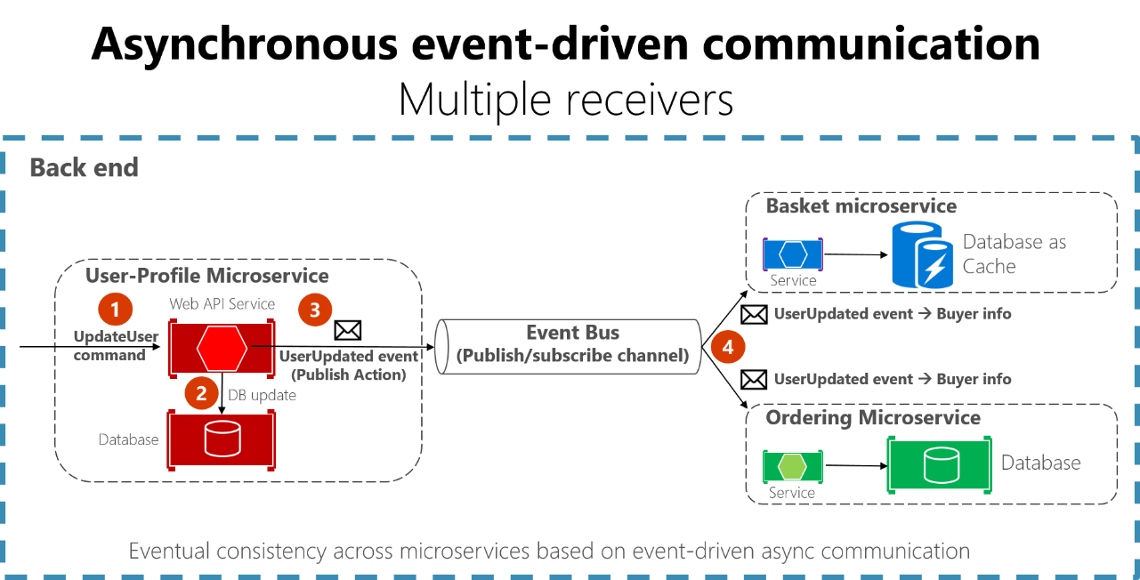
Communication Types – Publish Subscribe
In the publish-subscribe system, messages are persisted in a topic. Consumers can subscribe to one or more topics and consume all the messages in that topic.
Notes:
https://www.journaldev.com/8195/spring-boot-cli-setup-and-helloworld-example

Slide 29
Data Management

Slide 30
Database Management Patterns
Managing a microservices database is huge challenging job.
Microservices should have own data and microservices need to interact and share data with each other.
When interact or sharing data between microservices, The problem is, you can’t use ACID transactions between distributed systems. That means its challenging to implement queries and transactions that visits to several microservices.
5 common data-related patterns and 1 anti-pattern;
The Database-per-Service pattern
The API Composition pattern
The CQRS pattern
The Event Sourcing pattern
The Saga pattern
The Shared Database anti-pattern
Notes:
https://www.journaldev.com/8195/spring-boot-cli-setup-and-helloworld-example

Slide 31
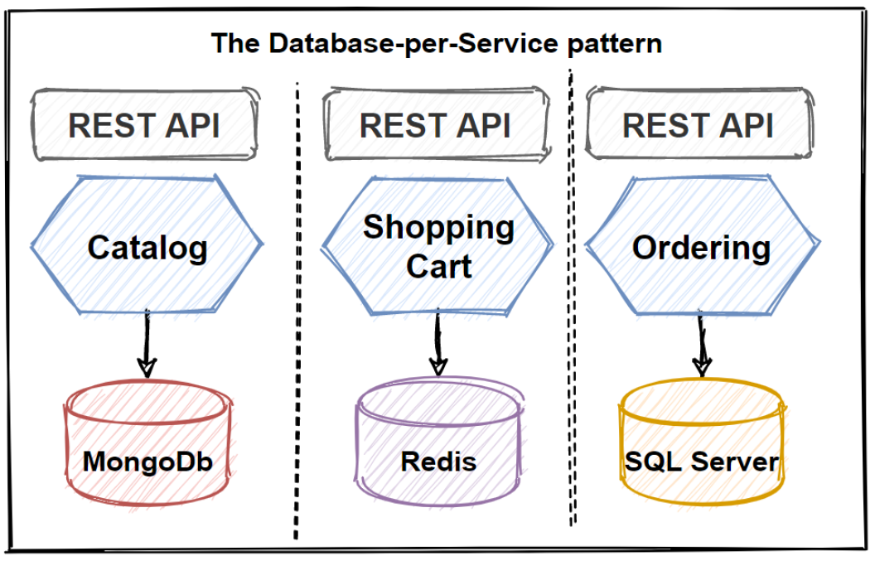
Database per Service
In order to be a loose coupling of services, each microservice should have its own private database.
It provide to evolve rapidly and easy to scale applications.
Data schema changes can perform without any impact on other microservices
Separating databases can gives us to abilities to pick the best optimized database for our microservices. We can choices include relational, document, key-value, and even graph-based data stores.
Notes:
https://www.journaldev.com/8195/spring-boot-cli-setup-and-helloworld-example

Slide 32
Database per Service – Resulting Context
Using a database per service has the following benefits:
Helps ensure that the services are loosely coupled.
Each service can use the type of database best suited to its needs.
Using a database per service has the following drawbacks:
Implementing business transactions that span multiple services is not straightforward.
Implementing queries that join data that is now in multiple databases is challenging.
Complexity of managing multiple SQL and NoSQL databases
There are various patterns/solutions for implementing transactions and queries that span services:
Implementing transactions that span services - use the Saga pattern.
Implementing queries that span services:
API Composition - the application performs the join rather than the database.
Command Query Responsibility Segregation (CQRS) - maintain one or more materialized views that contain data from multiple services.
Notes:
For example, a service that does text searches could use ElasticSearch. A service that manipulates a social graph could use Neo4j.
Distributed transactions are best avoided because of the CAP theorem. Moreover, many modern (NoSQL) databases don’t support them.
API Composition - the application performs the join rather than the database. For example, a service (or the API gateway) could retrieve a customer and their orders by first retrieving the customer from the customer service and then querying the order service to return the customer’s most recent orders.
Command Query Responsibility Segregation (CQRS) - maintain one or more materialized views that contain data from multiple services. The views are kept by services that subscribe to events that each services publishes when it updates its data. For example, the online store could implement a query that finds customers in a particular region and their recent orders by maintaining a view that joins customers and orders. The view is updated by a service that subscribes to customer and order events.

Slide 33
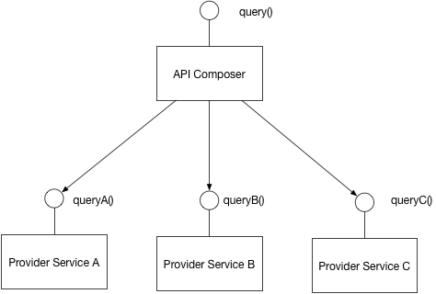
API Composition Pattern
It is no longer straightforward to implement queries that join data from multiple services.
Implement a query by defining an API Composer, which invoking the services that own the data and performs an in-memory join of the results.
Notes:
https://agniveshverma.medium.com/microservices-distributed-transaction-management-api-composition-part-2-7bd0f12f9cb2

Slide 34
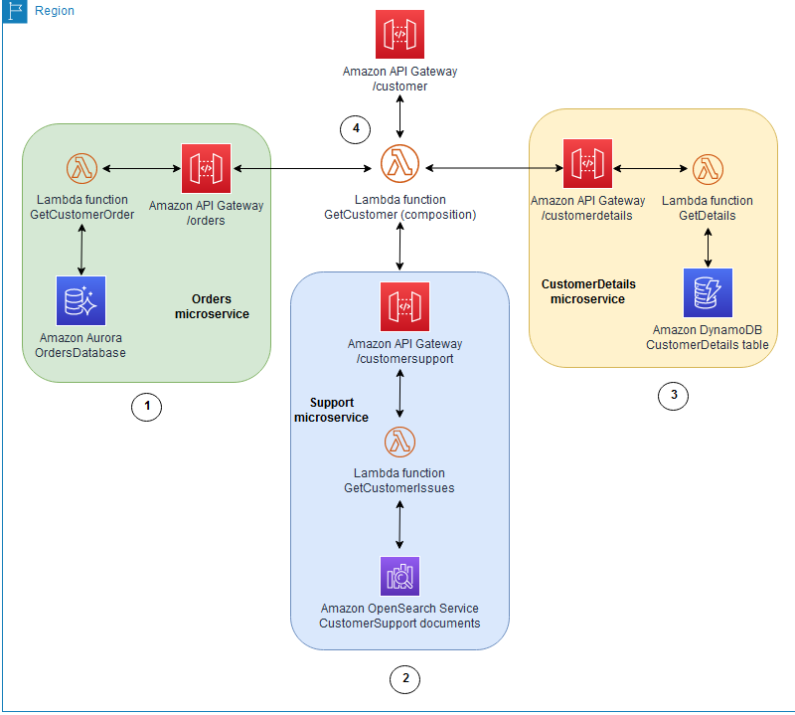
API Composition Pattern - disadvantages
It might not be suitable for complex queries and large datasets that require in-memory joins.
Your overall system becomes less available if you increase the number of microservices connected to the API composer.
Increased database requests create more network traffic, which increases your operational costs.
Notes:
An API gateway serves the "/customer" API, which has an "Orders" microservice that tracks customer orders in an Aurora database.
The "Support" microservice tracks customer support issues and stores them in an Amazon OpenSearch Service database.
The "CustomerDetails" microservice maintains customer attributes (for example, address, phone number, or payment details) in a DynamoDB table.
The “GetCustomer” Lambda function runs the APIs for these microservices, and performs an in-memory join on the data before returning it to the requester. This helps easily retrieve customer information in one network call to the user-facing API, and keeps the interface very simple.

Slide 35
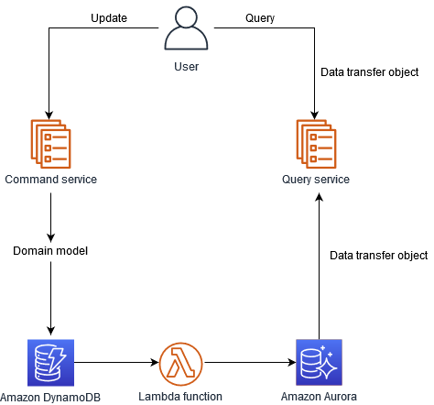
CQRS Pattern
Define a view database, which is a read-only replica that is designed to support that query.
The CQRS pattern splits the application into two parts: the command side and the query side.
The command side handles create, update, and delete requests. The query side runs the query part by using the read replicas.
Its based on write-less, read-more approaches
Notes:
The application keeps the replica up to data by subscribing to Domain events published by the service that own the data

Slide 36
Event Sourcing
The event sourcing pattern is typically used with the CQRS pattern to decouple read from write workloads, and optimize for performance, scalability, and security.
Data is stored as a series of events, instead of direct updates to data stores.
Microservices replay events from an event store to compute the appropriate state of their own data stores.
This pattern can be implemented by using either Amazon Kinesis Data Streams or Amazon EventBridge.
Notes:
https://docs.aws.amazon.com/prescriptive-guidance/latest/modernization-data-persistence/service-per-team.html

Slide 37
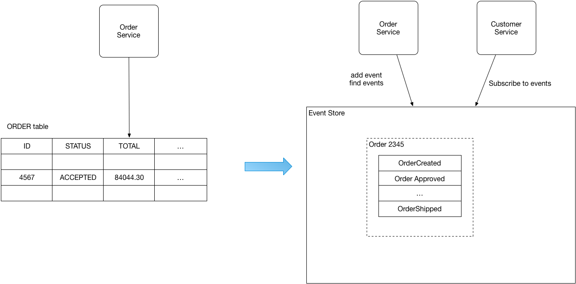
Event Sourcing
Notes:
The application keeps the replica up to data by subscribing to Domain events published by the service that own the data

Slide 38
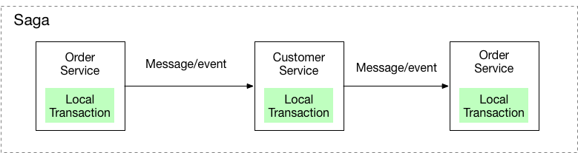
Saga pattern
Transaction management in really hard when it comes to microservices architectures. So in order to implementing transactions between several microservices and maintaining data consistency, we should follow the SAGA pattern.
A saga is a sequence of local transactions..
There are two ways of coordination sagas:
Choreography - each local transaction publishes domain events that trigger local transactions in other services
Orchestration - an orchestrator (object) tells the participants what local transactions to execute
Notes:
Each local transaction updates the database and publishes a message or event to trigger the next local transaction in the saga. If a local transaction fails because it violates a business rule then the saga executes a series of compensating transactions that undo the changes that were made by the preceding local transactions
https://blog.bitsrc.io/how-to-use-saga-pattern-in-microservices-9eaadde79748

Slide 39
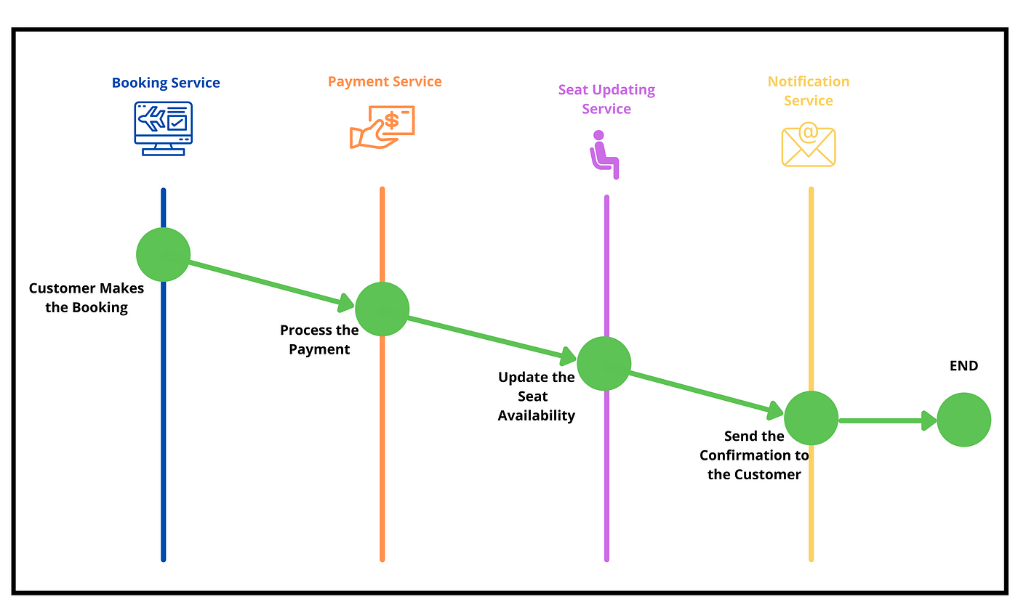
Saga pattern Example
Notes:
Each local transaction updates the database and publishes a message or event to trigger the next local transaction in the saga. If a local transaction fails because it violates a business rule then the saga executes a series of compensating transactions that undo the changes that were made by the preceding local transactions
https://blog.bitsrc.io/how-to-use-saga-pattern-in-microservices-9eaadde79748

Slide 40
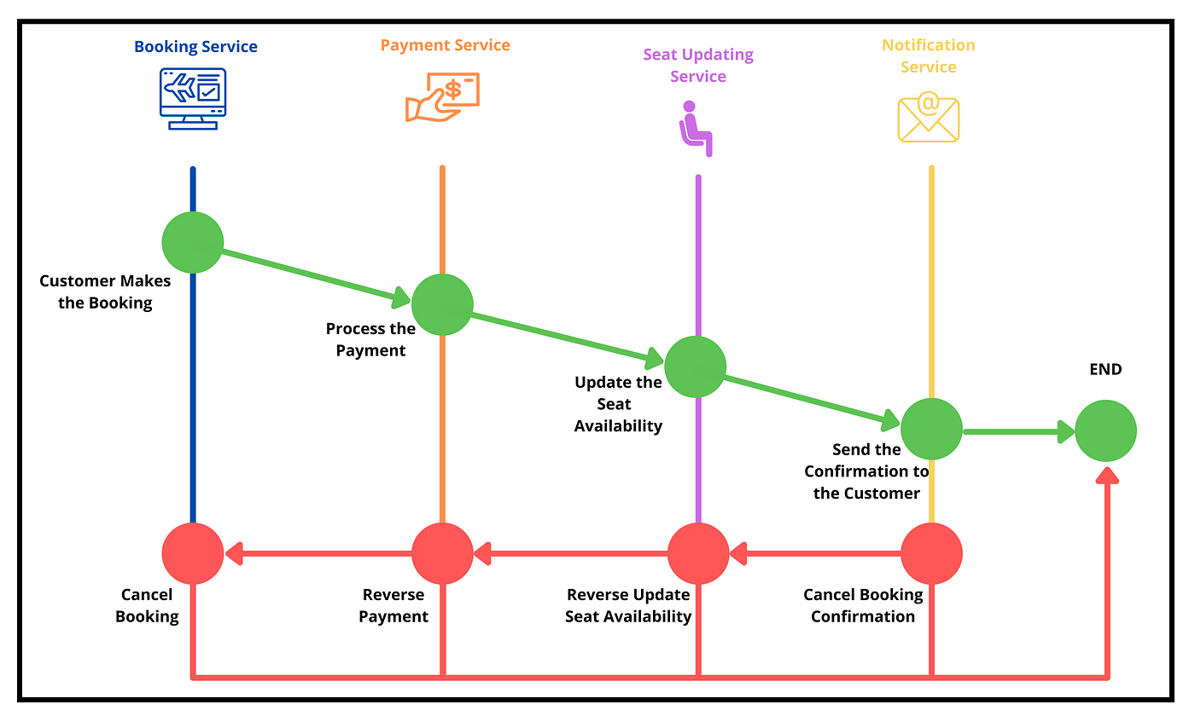
Saga pattern
It manages transactions that span across multiple Microservices using a sequence of local transactions.
These events are triggered by the Saga Execution Controller in case of a failure happens to ensure the system’s stability
Notes:
Each local transaction updates the database and publishes a message or event to trigger the next local transaction in the saga. If a local transaction fails because it violates a business rule then the saga executes a series of compensating transactions that undo the changes that were made by the preceding local transactions
https://blog.bitsrc.io/how-to-use-saga-pattern-in-microservices-9eaadde79748

Slide 41
Saga Execution Controller
Saga execution controller (SEC) is the centralized component that controls the local transactions and rollback events.
It tracks all the events of distributed transactions as a sequence and decides the rollback events in case of a failure.
Also, the SEC makes sure that rollback events do not have any additional effect other than reversing the local transactions.
Note: SEC internally uses a log named Saga log to keep track of all transactions
Notes:
Each local transaction updates the database and publishes a message or event to trigger the next local transaction in the saga. If a local transaction fails because it violates a business rule then the saga executes a series of compensating transactions that undo the changes that were made by the preceding local transactions
https://blog.bitsrc.io/how-to-use-saga-pattern-in-microservices-9eaadde79748

Slide 42
Orchestration
In Orchestration-Based Saga, a single orchestrator (arranger) manages all the transactions and directs services to execute local transactions.
The orchestrator acts as a centralized controller of all these local transactions and maintains the status of the complete transaction
Notes:
Each local transaction updates the database and publishes a message or event to trigger the next local transaction in the saga. If a local transaction fails because it violates a business rule then the saga executes a series of compensating transactions that undo the changes that were made by the preceding local transactions
https://blog.bitsrc.io/how-to-use-saga-pattern-in-microservices-9eaadde79748
https://www.vinsguru.com/orchestration-saga-pattern-with-spring-boot/

Slide 43
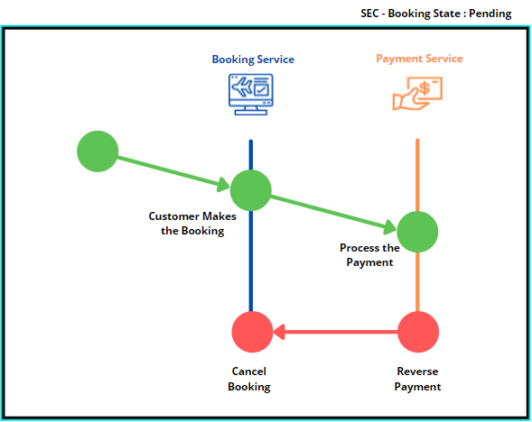
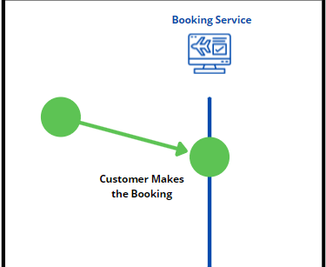
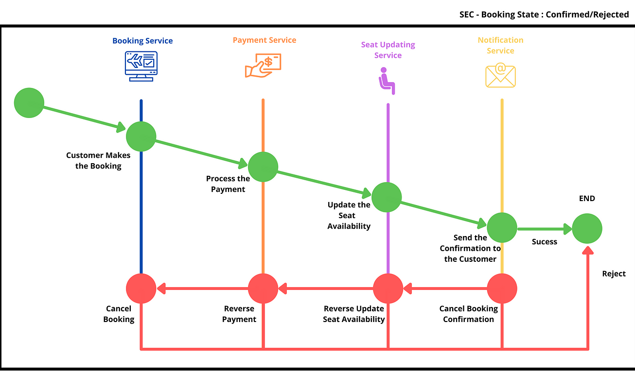
Orchestration
Notes:
After the payment is processed successfully, the orchestrator will call the seat updating service. Likewise, all the services will be called one by one, and the orchestrator will be notified whether the transactions are succeeded or failed.

Slide 44
Orchestration Use Case
When there are already implemented Microservices.
When a large number of Microservices participate in a single transaction.
Notes:
Each local transaction updates the database and publishes a message or event to trigger the next local transaction in the saga. If a local transaction fails because it violates a business rule then the saga executes a series of compensating transactions that undo the changes that were made by the preceding local transactions
https://blog.bitsrc.io/how-to-use-saga-pattern-in-microservices-9eaadde79748

Slide 45
Choreography
In Choreography-Based Saga, all the services that are part of the distributed transaction publish a new event after completing their local transaction.
The Choreography-Based Saga approach does not have an orchestrator to direct and execute local transactions. Instead, each Microservice is responsible for generating a new event. And it will trigger the transaction of the next Microservice.
Saga execution controller keeps track of all these events using the SEC log and executes rollback events in case of a failure.
Notes:
Each local transaction updates the database and publishes a message or event to trigger the next local transaction in the saga. If a local transaction fails because it violates a business rule then the saga executes a series of compensating transactions that undo the changes that were made by the preceding local transactions
https://blog.bitsrc.io/how-to-use-saga-pattern-in-microservices-9eaadde79748
https://www.vinsguru.com/choreography-saga-pattern-with-spring-boot/

Slide 46
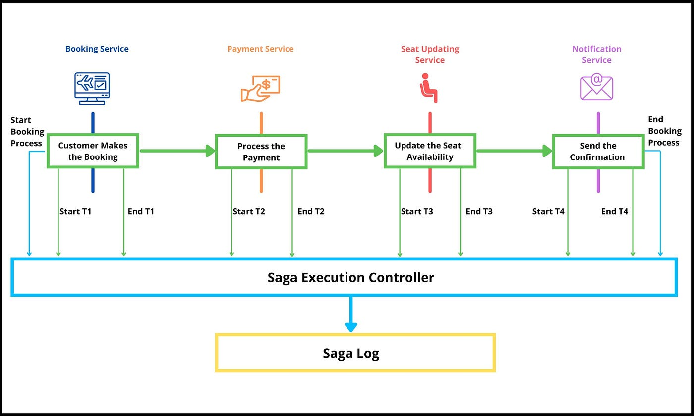
Choreography
Notes:
After the payment is processed successfully, the orchestrator will call the seat updating service. Likewise, all the services will be called one by one, and the orchestrator will be notified whether the transactions are succeeded or failed.

Slide 47
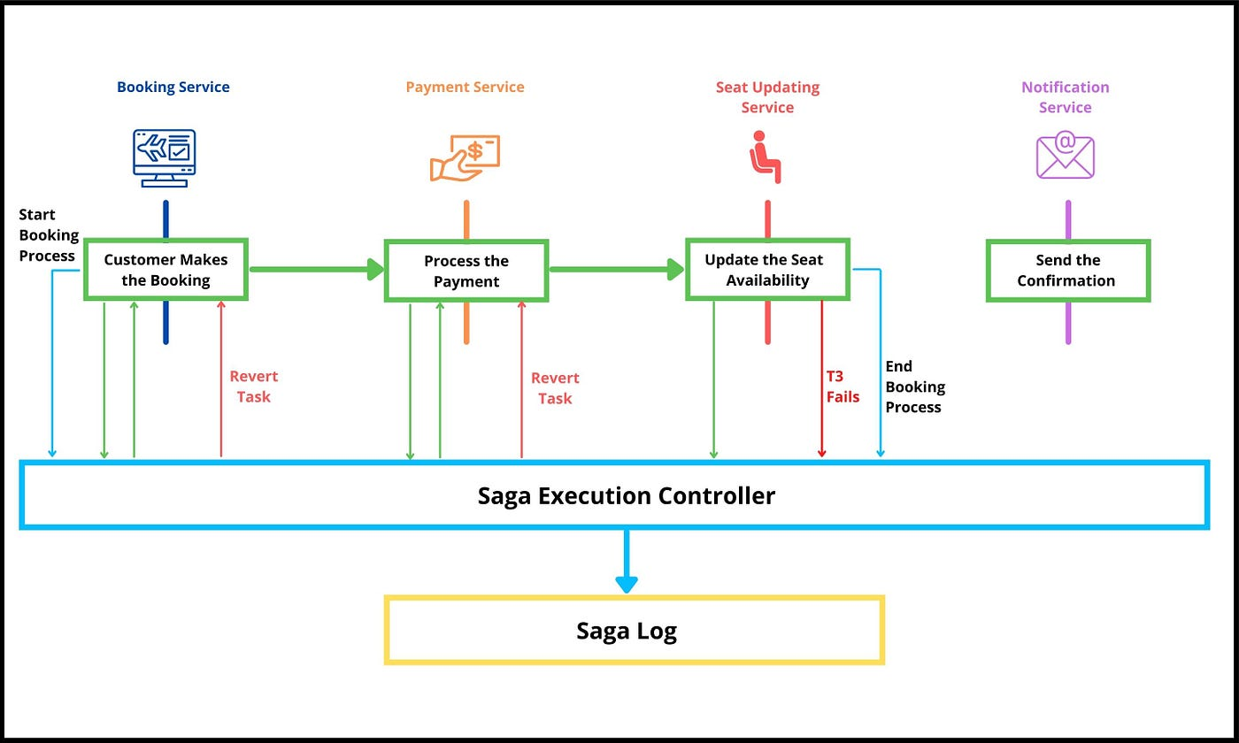
Choreography
Notes:
https://docs.aws.amazon.com/prescriptive-guidance/latest/modernization-data-persistence/service-per-team.html

Slide 48
Choreography Use Case
When you implement new Microservices from scratch.
When a small number of Microservices participate in a single transaction.
Notes:
Each local transaction updates the database and publishes a message or event to trigger the next local transaction in the saga. If a local transaction fails because it violates a business rule then the saga executes a series of compensating transactions that undo the changes that were made by the preceding local transactions
https://blog.bitsrc.io/how-to-use-saga-pattern-in-microservices-9eaadde79748

Slide 49
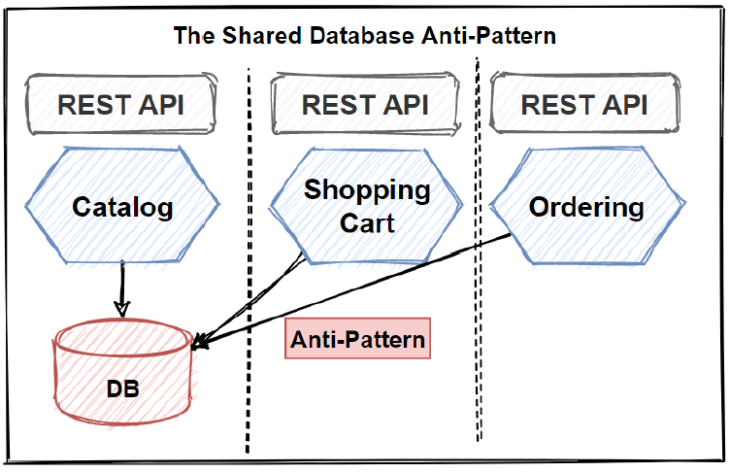
Shared Database
If you don’t follow The Database-per-Service pattern and use Shared Database for several microservices, then it is anti-pattern and you should avoid this approaches.
Notes:
Each local transaction updates the database and publishes a message or event to trigger the next local transaction in the saga. If a local transaction fails because it violates a business rule then the saga executes a series of compensating transactions that undo the changes that were made by the preceding local transactions

Slide 50
Shared Database – Pros and Cons
The benefits of this pattern are:
A developer uses familiar and straightforward ACID transactions to enforce data consistency
A single database is simpler to operate
The drawbacks of this pattern are:
Development time coupling - a developer working on, for example, the OrderService will need to coordinate schema changes with the developers of other services that access the same tables. This coupling and additional coordination will slow down development.
Runtime coupling - because all services access the same database they can potentially interfere with one another. For example, if long running CustomerService transaction holds a lock on the ORDER table then the OrderService will be blocked.
Single database might not satisfy the data storage and access requirements of all services.
Notes:
Each local transaction updates the database and publishes a message or event to trigger the next local transaction in the saga. If a local transaction fails because it violates a business rule then the saga executes a series of compensating transactions that undo the changes that were made by the preceding local transactions

Slide 51
Twelve factor App

Slide 52
What
The twelve-factor methodology is a set of twelve best practices to develop applications developed to run as a service.
This was originally drafted by Heroku for applications deployed as services on their cloud platform, back in 2011. Over time, this has proved to be generic enough for any software-as-a-service (SaaS) development.
If we design our software to be modular, portable, and scalable on modern cloud platforms, it's quite amenable to our service offerings. This is where the twelve-factor methodology helps in
Notes:
https://www.journaldev.com/8195/spring-boot-cli-setup-and-helloworld-example

Slide 53
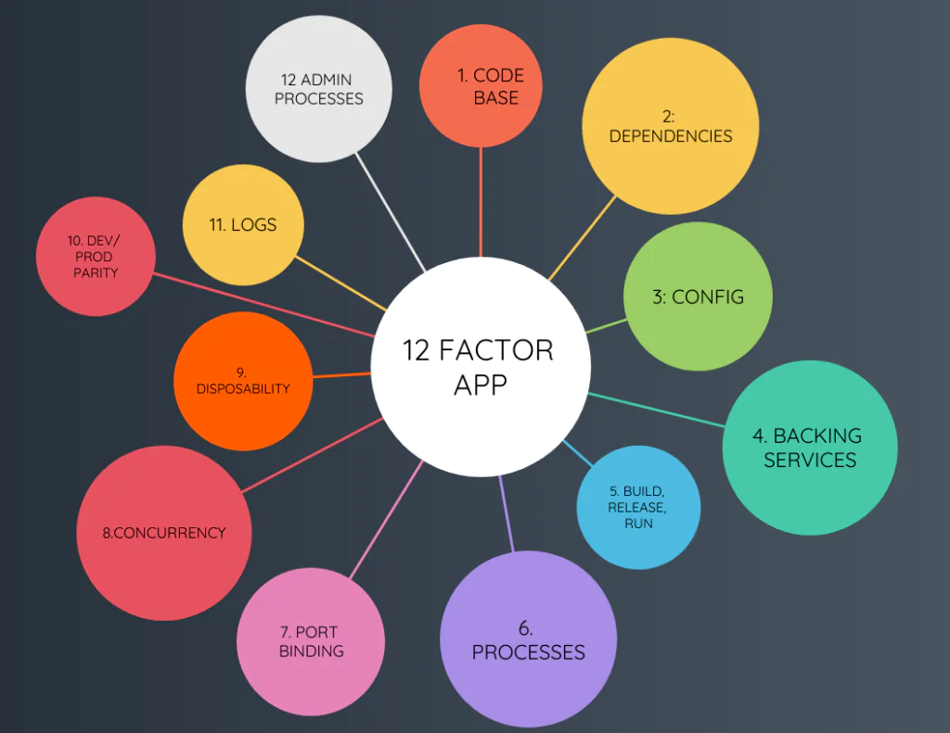
Notes:
https://www.journaldev.com/8195/spring-boot-cli-setup-and-helloworld-example

Slide 54
Goals
A common theme running through all the twelve principles is making the application portable to meet the demands of a dynamic environment provisioning typical of cloud platforms. The goals of the Twelve-Factor App as asserted in the documentation are:
Using declarative formats to automate the setup.
Maximizing portability across execution environments
Suitable for deployment in Cloud Platforms
Minimizing divergence between development and production by enabling continuous deployment for maximum agility
Ability to scale up without significant changes to tooling, architecture, or development practices.
Notes:
https://reflectoring.io/spring-boot-12-factor-app/

Slide 55
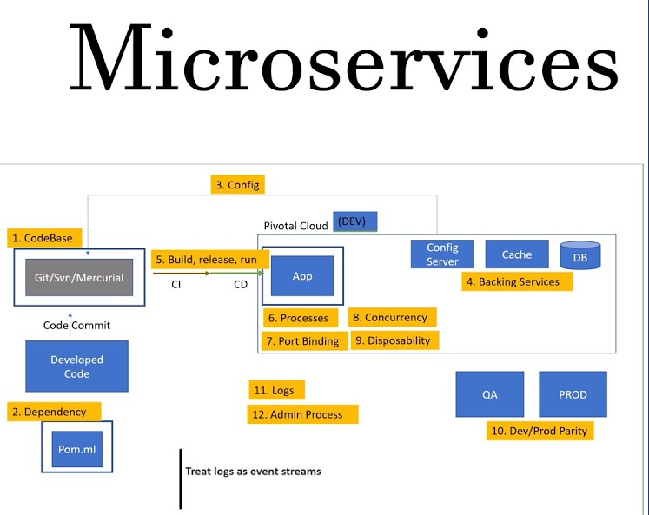
Notes:
https://www.journaldev.com/8195/spring-boot-cli-setup-and-helloworld-example

Slide 56
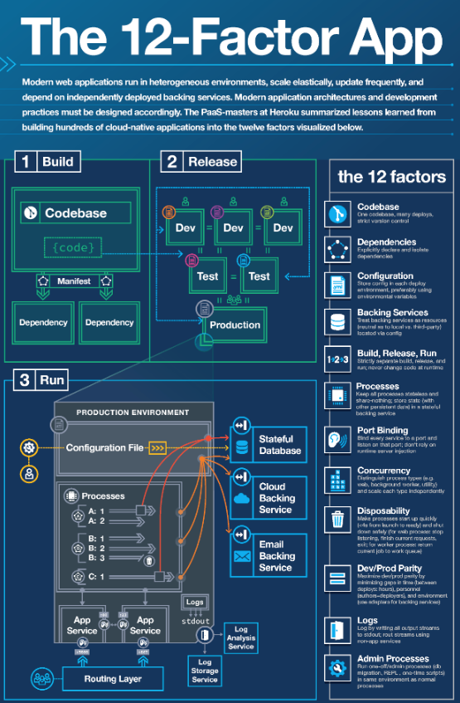
Notes:
https://www.journaldev.com/8195/spring-boot-cli-setup-and-helloworld-example

Slide 57
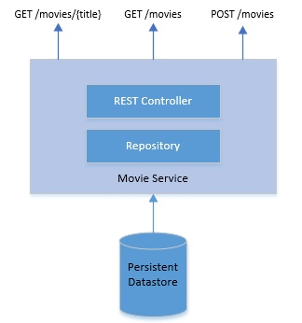
Case Study
We all love watching movies, but it's challenging to keep track of the movies we've already watched.
Notes:
A client makes HTTP(s) requests (or opens TCP connections) to the ELB, which load balances the traffic amongst a set of EC2 instances. An ELB can load balance either external traffic from the Internet or, when deployed in a VPC, load balance internal traffic.. EC2 instances are registered with the ELB either explicitly via an API call or automatically as part of an auto-scaling group

Slide 58
Codebase
The first best practice of twelve-factor apps is to track it in a version control system.
Git is the most popular version control system in use today and is almost ubiquitous.
The principle states that an app should be tracked in a single code repository and must not share that repository with any other apps.
Notes:
A client makes HTTP(s) requests (or opens TCP connections) to the ELB, which load balances the traffic amongst a set of EC2 instances. An ELB can load balance either external traffic from the Internet or, when deployed in a VPC, load balance internal traffic.. EC2 instances are registered with the ELB either explicitly via an API call or automatically as part of an auto-scaling group

Slide 59
Dependencies
Next, the twelve-factor app should always explicitly declare all its dependencies.
We should do this using a dependency declaration manifest. Java has multiple dependency management tools like Maven and Gradle.
So, our simple application depends on a few external libraries, like a library to facilitate REST APIs and to connect to a database.
Notes:
For example, Netflix Eureka service instances are typically deployed using elastic IP addresses. The available pool of Elastic IP addresses is configured using either a properties file or via DNS. When a Eureka instance starts up it consults the configuration to determine which available Elastic IP address to use. A Eureka client is also configured with the pool of Elastic IP addresses.

Slide 60
Configurations
An application typically has lots of configuration, some of which may vary between deployments while others remain the same.
In our example, we've got a persistent database. We'll need the address and credentials of the database to connect to. This is most likely to change between deployments.
A twelve-factor app should externalize all such configurations that vary between deployments. The recommendation here is to use environment variables for such configurations. This leads to a clean separation of config and code.
Spring provides a configuration file where we can declare such configurations and attach it to environment variables:
We can use a configuration management tool like Ansible or Chef to automate this process.
Notes:
https://www.journaldev.com/8195/spring-boot-cli-setup-and-helloworld-example

Slide 61
Backing Services
Backing services are services that the application depends on for operation.
For instance a database or a message broker. A twelve-factor app should treat all such backing services as attached resources.
What this effectively means is that it shouldn't require any code change to swap a compatible backing service. The only change should be in configurations.
Spring JPA makes the code quite agnostic to the actual database provider. We only need to define a repository which provides all standard operations:
Notes:
https://www.journaldev.com/8195/spring-boot-cli-setup-and-helloworld-example

Slide 62
Build, Release and Run
The twelve-factor methodology strictly separates the process of converting codebase into a running application as three distinct stages:
Build Stage: This is where we take the codebase, perform static and dynamic checks, and then generate an executable bundle like a JAR. Using a tool like Maven, this is quite trivial: mvn clean compile test package
Release Stage: This is the stage where we take the executable bundle and combine this with the right configurations. Here, we can use Packer with a provisioner like Ansible to create Docker images: packer build application.json
Run Stage: Finally, this is the stage where we run the application in a target execution environment. If we use Docker as the container to release our application, running the application can be simple enough:
docker run --name <container_id> -it <image_id>
Finally, we don't necessarily have to perform these stages manually. This is where Jenkins comes in as pretty handy with their declarative pipeline
Notes:
http://www.springboottutorial.com/microservices-with-spring-boot-part-5-eureka-naming-server

Slide 63
Processes
A twelve-factor app is expected to run in an execution environment as stateless processes.
In other words, they can not store persistent state locally between requests.
They may generate persistent data which is required to be stored in one or more stateful backing services.
if we keep track of user requests in-memory and use that information to serve future requests, it violates a twelve-factor app.
Hence, a twelve-factor app imposes no such restriction like sticky sessions. This makes such an app highly portable and scalable. In a cloud execution environment offering automated scaling, it's quite a desirable behavior from applications.
Notes:
http://www.springboottutorial.com/microservices-with-spring-boot-part-5-eureka-naming-server

Slide 64
Port Binding
A traditional web application in Java is developed as a WAR or web archive.
This is typically a collection of Servlets with dependencies, and it expects a conformant container runtime like Tomcat.
A twelve-factor app, on the contrary, expects no such runtime dependency. It's completely self-contained and only requires an execution runtime like Java.
Spring Boot, apart from many other benefits, provides us with a default embedded application server. Hence, the JAR we generated earlier using Maven is fully capable of executing in any environment just by having a compatible Java runtime: java -jar application.jar
Notes:
http://www.springboottutorial.com/microservices-with-spring-boot-part-5-eureka-naming-server

Slide 65
Concurrency
Java offers Thread as a classical model to handle concurrency in an application. Threads are powerful but have limitations in terms of how much it can help an application scale.
The twelve-factor methodology suggests apps to rely on processes for scaling.
What this effectively means is that applications should be designed to distribute workload across multiple processes. Individual processes are, however, free to leverage a concurrency model like Thread internally.
A Java application, when launched gets a single process which is bound to the underlying JVM. What we effectively need is a way to launch multiple instances of the application with intelligent load distribution between them.
Since we've already packaged our application as a Docker container, Kubernetes is a natural choice for such orchestration.
Notes:
http://www.springboottutorial.com/microservices-with-spring-boot-part-5-eureka-naming-server

Slide 66
Disposability
Application processes can be shut down on purpose or through an unexpected event.
In either case, a twelve-factor app is supposed to handle it gracefully. In other words, an application process should be completely disposable without any unwanted side-effects.
Moreover, processes should start quickly
In summary, the application should expose idempotent services.
This is another very desirable attribute of a service destined for cloud deployments.
This gives the flexibility to stop, move, or spin new services at any time without any other considerations.
Notes:
For instance, in our application, one of the endpoints is to create a new database record for a movie. Now, an application handling such a request may crash unexpectedly. This should, however, not impact the state of the application. When a client sends the same request again, it shouldn't result in duplicate records.

Slide 67
Dev / Prod parity
It's typical for applications to be developed on local machines, tested on some other environments and finally deployed to production.
It's often the case where these environments are different.
The twelve-factor methodology suggests keeping the gap between development and production environment as minimal as possible. These gaps can result from long development cycles, different teams involved, or different technology stack in use.
technology like Spring Boot and Docker automatically bridge this gap to a great extent
We must use the same backing services – like the database – as well.
Moreover, we should have the right processes like continuous integration and delivery to facilitate bridging this gap further.
Notes:
For instance, in our application, one of the endpoints is to create a new database record for a movie. Now, an application handling such a request may crash unexpectedly. This should, however, not impact the state of the application. When a client sends the same request again, it shouldn't result in duplicate records.

Slide 68
Logs
Logs are essential data that an application generates during its lifetime. They provide invaluable insights into the working of the application.
Typically an application can generate logs at multiple levels with varying details and output ii in multiple different formats.
A twelve-factor app, however, separates itself from log generation and its processing.
For such an app, logs are nothing but a time-ordered stream of events. It merely writes these events to the standard output of the execution environment.
The capture, storage, curation, and archival of such stream should be handled by the execution environment.
There are quite several tools available to us for this purpose. To begin with, we can use SLF4J to handle logging abstractly within our application. Moreover, we can use a tool like Fluentd to collect the stream of logs from applications and backing services.
This we can feed into Elasticsearch for storage and indexing. Finally, we can generate meaningful dashboards for visualization in Kibana.
Notes:
For instance, in our application, one of the endpoints is to create a new database record for a movie. Now, an application handling such a request may crash unexpectedly. This should, however, not impact the state of the application. When a client sends the same request again, it shouldn't result in duplicate records.

Slide 69
Admin Process
The idea here is to separate administrative tasks from the rest of the app to prevent one-off tasks from causing issues with your running apps.
Containers make this easy, as you can spin up a container just to run a task and then shut it down.
Examples include doing data cleanup, running analytics for a presentation, or turning on and off features for A/B testing.
Though the admin processes are separate, you must continue to run them in the same environment and against the base code and config of the app itself.
Shipping the admin tasks code alongside the app prevents drift.
we can use Groovy integrated with Java runtime to start such processes.
Notes:
For instance, in our application, one of the endpoints is to create a new database record for a movie. Now, an application handling such a request may crash unexpectedly. This should, however, not impact the state of the application. When a client sends the same request again, it shouldn't result in duplicate records.

Slide 70
Hexagonal pattern
Notes:
https://www.happycoders.eu/software-craftsmanship/hexagonal-architecture/

Slide 71
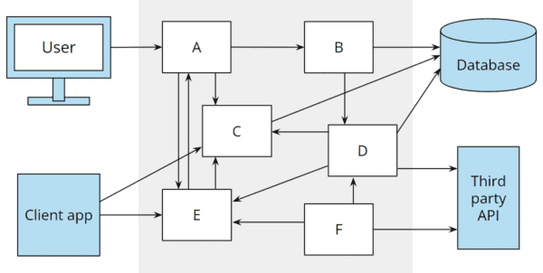
Architecture
By architecture, we mean the division of a system into components, the arrangement and characteristics of these components, and the way these components communicate with each other.
Good architecture allows the software to be changed during its lifetime with as little, constant effort as possible (and correspondingly predictable costs for the client).
Notes:
To deploy your service using this approach, you package the code (e.g. as a ZIP file), upload it to the deployment infrastructure and describe the desired performance characteristics.
The deployment infrastructure is a utility operated by a public cloud provider. It typically uses either containers or virtual machines to isolate the services. However, these details are hidden from you. Neither you nor anyone else in your organization is responsible for managing any low-level infrastructure such as operating systems, virtual machines, etc.

Slide 72
Architecture Changes
Changes could be:
Implementation of customer requests.
Adjustments to reflect changes in legal requirements.
Using more modern technologies (e.g., replacing a SOAP API with a REST API).
Upgrading infrastructure components (e.g., upgrading the database server or ORM library to a new version).
Exchanging third-party systems (such as an external billing or newsletter delivery system).
And even replacing the application server (e.g., Quarkus instead of Glassfish).

Slide 73
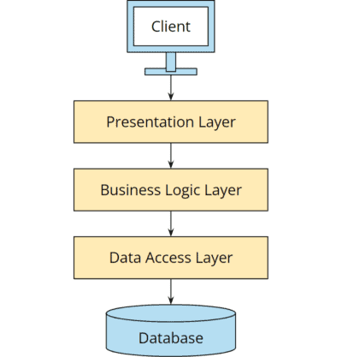
How to Develop a Good Software Architecture?
To keep software “soft,” the application should be divided into well-isolated, independently developable, and testable components.

Slide 74
Disadvantages Of layered Architecture
Layered architecture leads to unnecessary coupling with negative consequences:
The business logic directly depends on the database, while the presentation layer has a transitive dependency.
it is not uncommon for errors to occur because an attempt is made in the presentation layer to iterate over an uninitialized one-to-many collection of a JPA entity. And so we have to worry about technical issues such as transactions and lazy and eager loading in the business layer.
The coupling also makes it unnecessarily difficult to upgrade the database or data access layer (e.g., to a new database version or a new version of the O/R mapper).
The weakening of layer boundaries also makes it impossible to test individual components in isolation – e.g., the business logic without a user interface and database.

Slide 75
Hexagonal Architecture
Alistair Cockburn introduced the hexagonal software architecture in a blog article in 2005. Cockburn states the following goals:
The application should be equally controllable by users, other applications, or automated tests.
The business logic should be able to be developed and tested in isolation from the database, other infrastructure, and third-party systems.
Infrastructure modernization should be possible without adjustments to the business logic.
Hexagonal Architecture draws a thick line between the software’s inside and outside parts, decoupling the business logic from the persistence and the service layer.
Notes:
The inside part makes up the use cases and the domain model it’s built upon. The outside part includes UI, database, etc. The connection between them is realized via ports and their implementation counterparts are called adapters. In this way, Hexagonal Architecture ensures encapsulation of logic in different layers, which ensures higher testability and control over the code.
https://medium.com/sciforce/another-story-about-microservices-hexagonal-architecture-23db93fa52a2
https://medium.com/javarevisited/hands-on-hexagonal-architecture-with-spring-boot-ca61f88bed8b
https://github.com/sofieneBK/hands-on-hexagonal-architecture-with-spring-boot

Slide 76
Why Hexagon
The hexagon shape (as in the above example) is simply a convenient way to depict that in this particular architecture:
The core logic and services are inside,
They communicate with various external actors (ends) using Ports and Adapters,
Those can be divided into driving and driven actors, which again is easy to depict using a symmetrical shape.
Notes:
The inside part makes up the use cases and the domain model it’s built upon. The outside part includes UI, database, etc. The connection between them is realized via ports and their implementation counterparts are called adapters. In this way, Hexagonal Architecture ensures encapsulation of logic in different layers, which ensures higher testability and control over the code.
https://medium.com/sciforce/another-story-about-microservices-hexagonal-architecture-23db93fa52a2

Slide 77
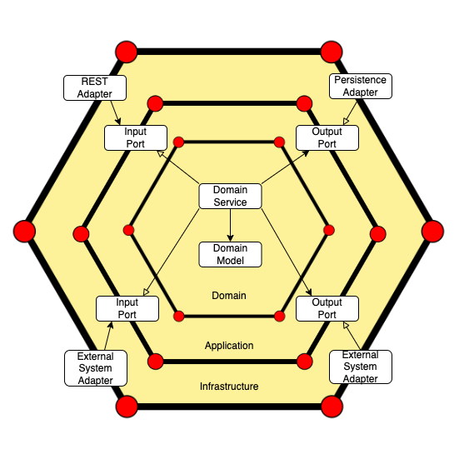
Notes:
The inside part makes up the use cases and the domain model it’s built upon. The outside part includes UI, database, etc. The connection between them is realized via ports and their implementation counterparts are called adapters. In this way, Hexagonal Architecture ensures encapsulation of logic in different layers, which ensures higher testability and control over the code.
https://medium.com/sciforce/another-story-about-microservices-hexagonal-architecture-23db93fa52a2

Slide 78
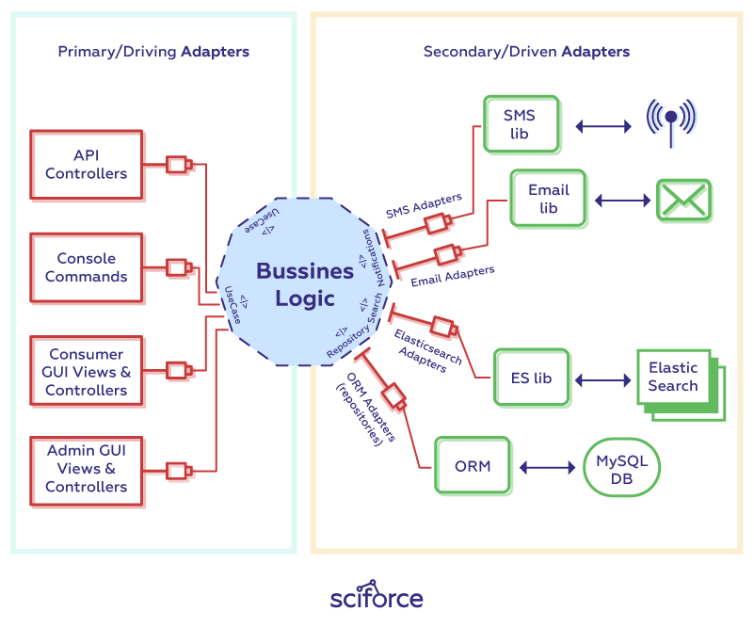
Architecture Components
Each side of the hexagon represents an input — port that uses an adapter for the specific type. Hence, ports and adapters form two major components of Hexagon Architecture:

Slide 79
Ports
A port is a gateway, provided by the core logic. It allows the entry or exiting of data to and from the application. The simplest implementation of a Port is an API layer. Ports exist in 2 types: inbound and outbound.
An inbound port is the only part of the core exposed to the world that defines how the Core Business Logic can be used.
An outbound port is an interface the core needs to communicate with the outside world
Notes:
A service must be provided with configuration data that tells it how to connect to the external/3rd party services. For example, the database network location and credentials
A service must run in multiple environments - dev, test, qa, staging, production - without modification and/or recompilation
Different environments have different instances of the external/3rd party services, e.g. QA database vs. production database, test credit card processing account vs. production credit card processing account

Slide 80
Adapters
An adapter transforms one interface into another, creating a bridge between the application and the service that it needs.
In hexagonal architecture all communication between the primary (which use system to achieve a particular goal) and secondary actors (which system uses to achieve primary actor’s goals) and application ports is done with the help of adapters. Therefore, adapters can also be of two types:
Primary
Secondary

Slide 81
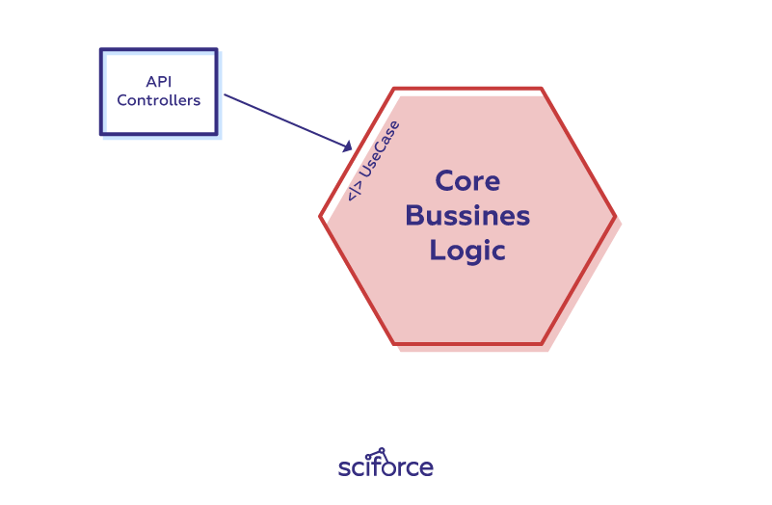
Primary Adapters
The primary or Driving Adapters represents the UI. It is a piece of code between the user and the core logic.
They are called driving adapters because they drive the application, and start actions in the core application.
Examples of a primary adapters are API controllers, Web controllers or views.

Slide 82
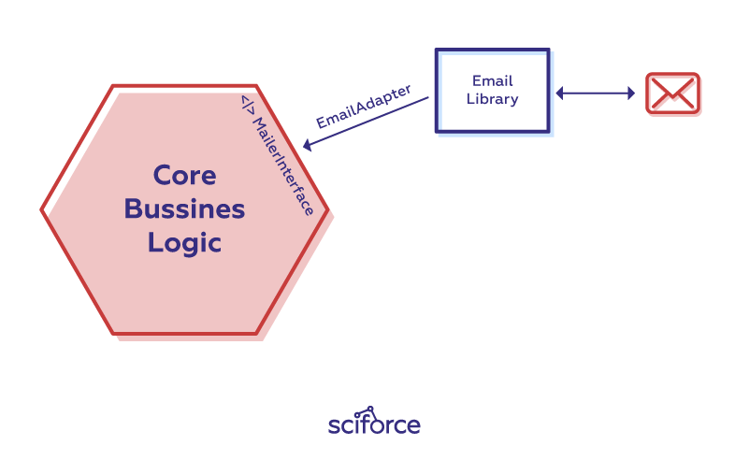
Secondary Adapters
The secondary or Driven Adapters represent the connection to back-end databases, external libraries, mail API’s, etc.
It is an implementation of the secondary port, which is an interface. These adapters react to actions initiated by the primary adapters.

Slide 83
Domain Model
The third component of the architecture is the domain model, a conceptual model that represents meaningful concepts to the domain that need to be modelled in software.
The concepts include the data involved in the business and rules the business uses in relation to that data.

Slide 84
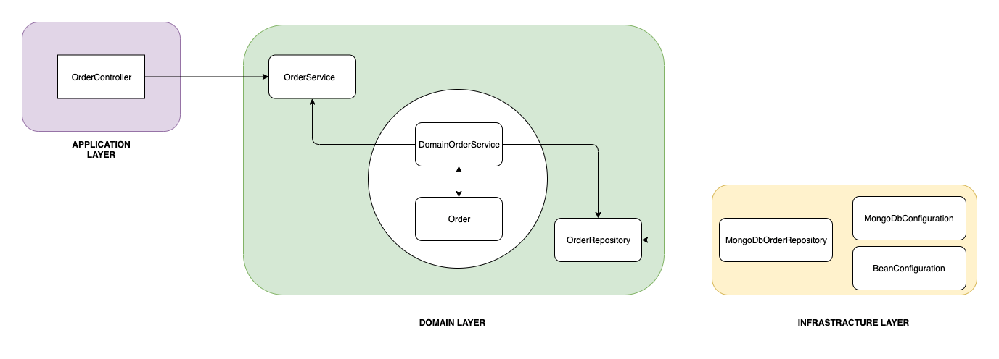
Notes:
https://baeldung.com/hexagonal-architecture-ddd-spring

Slide 85
ThankYou
shalini06mittal@gmail.com
7738460004

